Slide 1


Group 4
Members:
Trần Huy Hiệp (Leader)
Nguyễn Thế Hào
Nguyễn Việt Anh
Phạm Công Định
Nguyễn Đức Lộc

Slide 2


1.4. What kinds of Patterns Can Be Mined?

Slide 3


Characterization and Discrimination.
1

Slide 4


1. Characterization and Discrimination.
Data characterization is a summarization of the general characteristics or features of a target class of data.
Example:
Summarize the characteristics of customers who spend more than $5000 a year at AllElectronics.
Result:
A general profile of these customers, such as that they are 40 to 50 years old, employed, and have excellent credit ratings

Slide 5
1. Class/Concepts Description: Characterization and Discrimination.
Data discrimination is a comparison of the general features of the target class data objects.
Example:
Compare two groups of customers—those who shop for computer products regularly (more than twice a month) and those who rarely shop for such products (less than three times a year).
Result:
80% of the customers who frequently purchase computer products are between 20 and 40 years old and have a university education, whereas 60% of the customers who infrequently buy such products are either seniors or youths, and have no university degree

Slide 6
MINING frequent patterns, asociations, and corelations.
2

Slide 7

2. MINING frequent patterns, asociations, and corelations.
Frequent Pattern is a pattern which appears frequently in a data set.
By identifying frequent patterns we can observe strongly correlated items together and easily identify similar characteristics, associations among them.
Example:
Milk and bread, which are often bought together by many customers in grocery stores

Slide 8
Classification and regression for predictive analysis
3

Slide 9
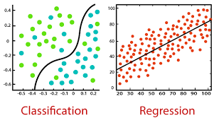
3. Classification and Regression for Predictive Analysis
Classification is the process of finding a model (or function) that describes and distinguishes data classes or concepts.
Classification gives out discrete values.
The nature of the predicted data is unordered.

Slide 10
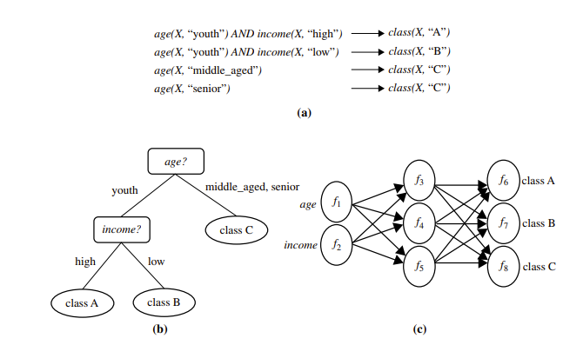
3. Classification and Regression for Predictive Analysis
The derived model may be represented in various forms:
Classification rules (i.e., IF-THEN rules)
Decision trees
Neural networks

Slide 11
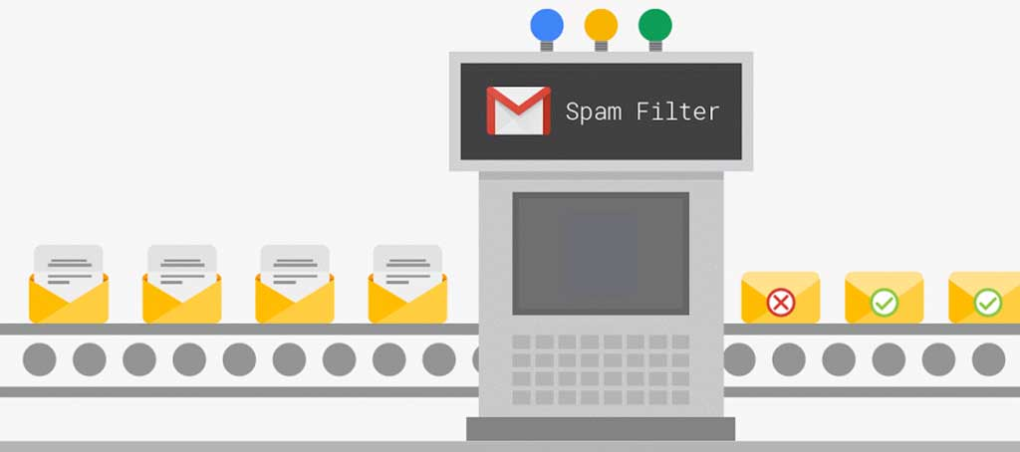
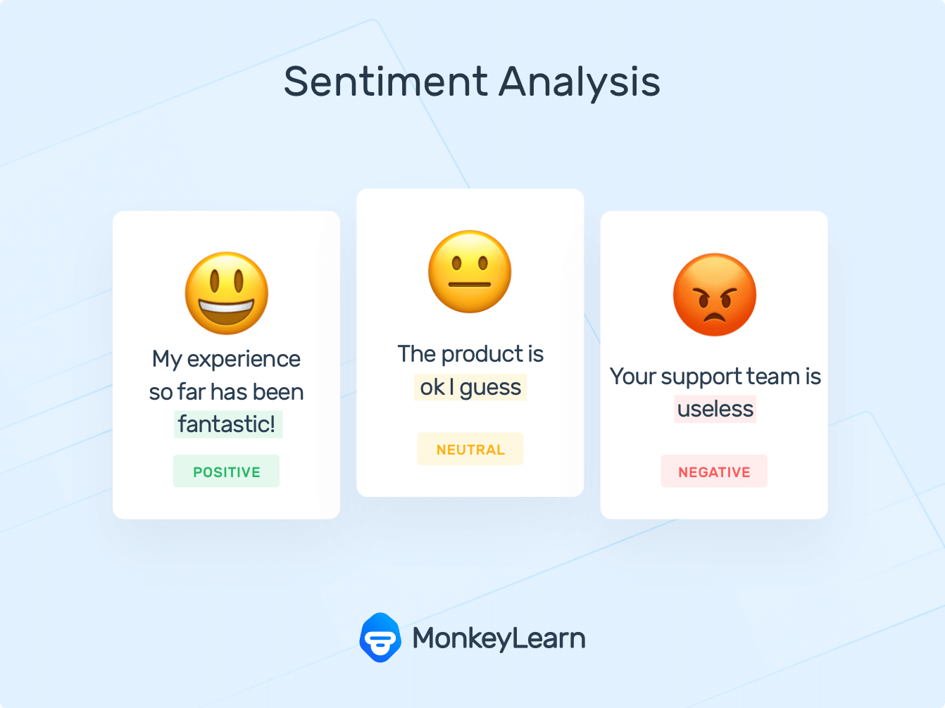
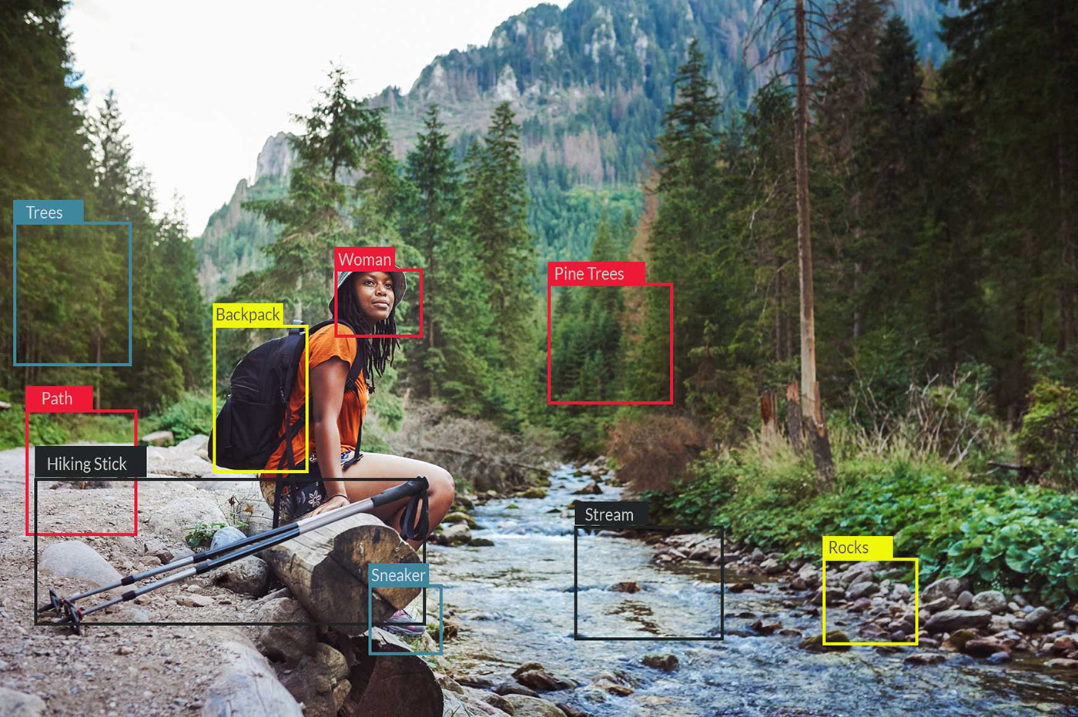
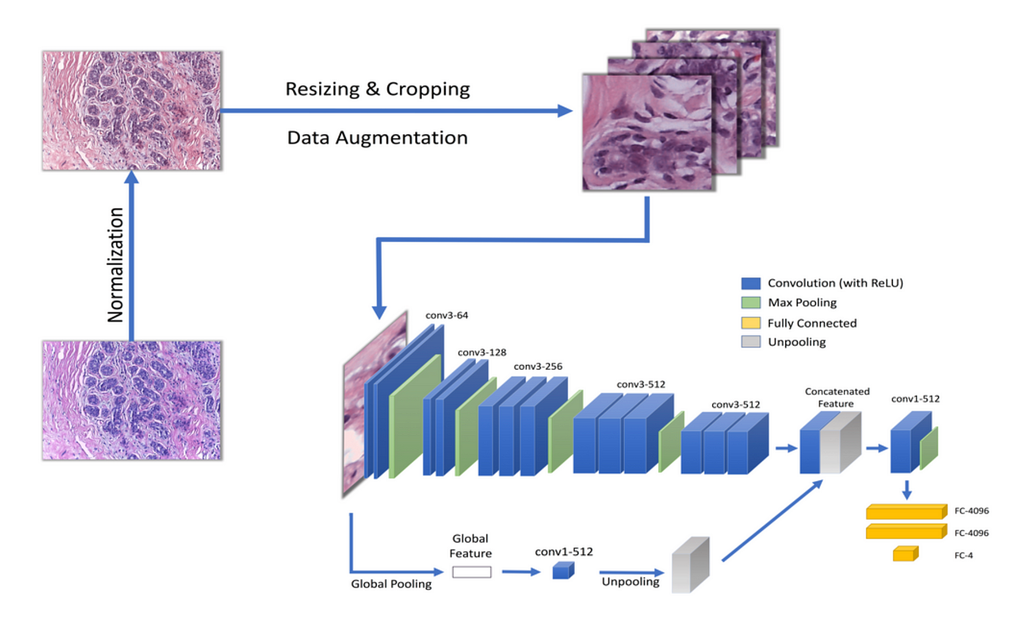
3. Classification and Regression for Predictive Analysis
Example:
Spam detection
Image recognition
Sentiment analysis
Helps determine whether cell clusters are benign or malignant.

Slide 12
3. Classification and Regression for Predictive Analysis
While classification assigns data into discrete categories, Regression is a data mining technique used to predict a range of numeric values (also called continuous values), given a particular dataset.
Regression gives continuous values.
Output Variable Type is Continuous variable

Slide 13
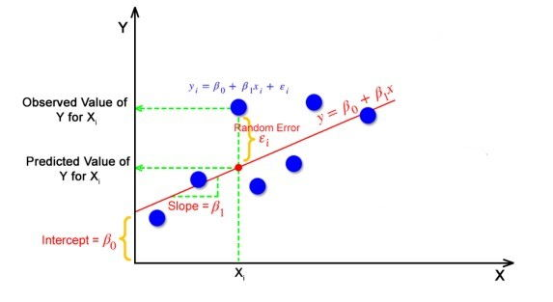
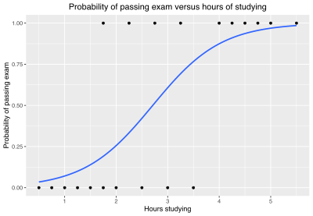
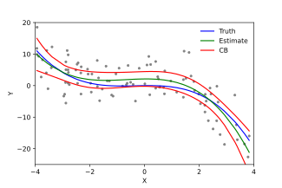
3. Classification and Regression for Predictive Analysis
Several types of regression models:
Linear regression
Logistic regression
Polynomial regression

Slide 14

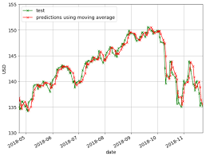
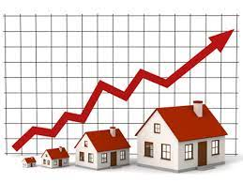
3. Classification and Regression for Predictive Analysis
Example:
Stock price prediction
House price prediction
Demand forecasting

Slide 15
Cluster analysis
4

Slide 16
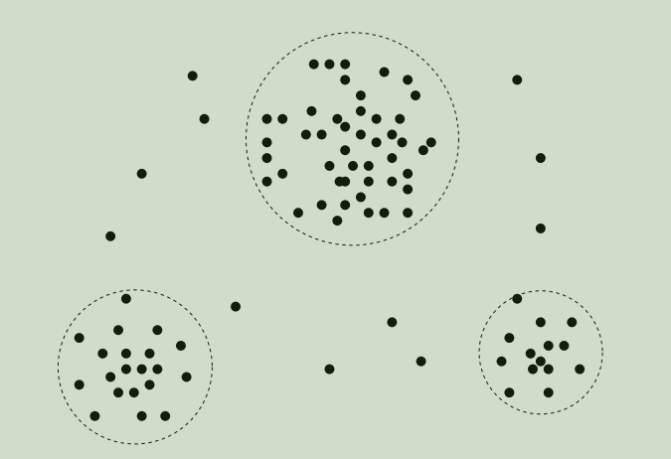

4. Cluster analysis
Analyze class-labeled (training) data sets, clustering analyzes data objects without consulting class labels

Slide 17
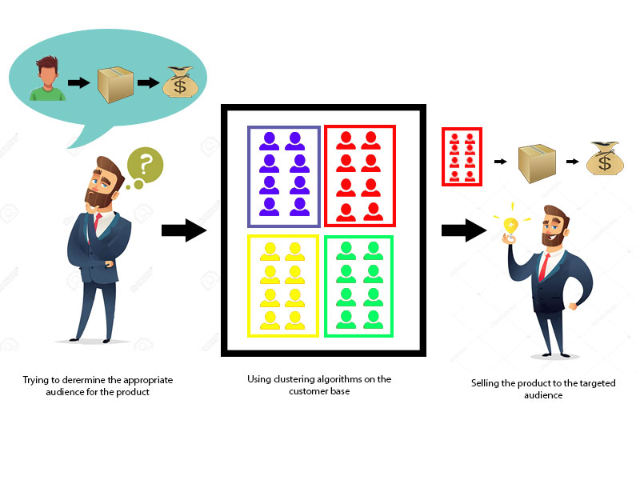
4. Cluster analysis
Example:
Now that the data from our customer base is divided into clusters, we can make an informed decision about who we think is best suited for this product.

Slide 18
Outlier analysis
5

Slide 19
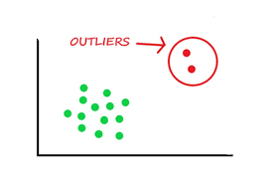
5. Outlier Analysis
Outlier data is data set may contain objects that do not comply with the general behavior or model of the data.
Outliers may be detected :
Using statistical tests that assume a distribution.
Using distance measures where objects that are remote from any other cluster are considered outliers

Slide 20
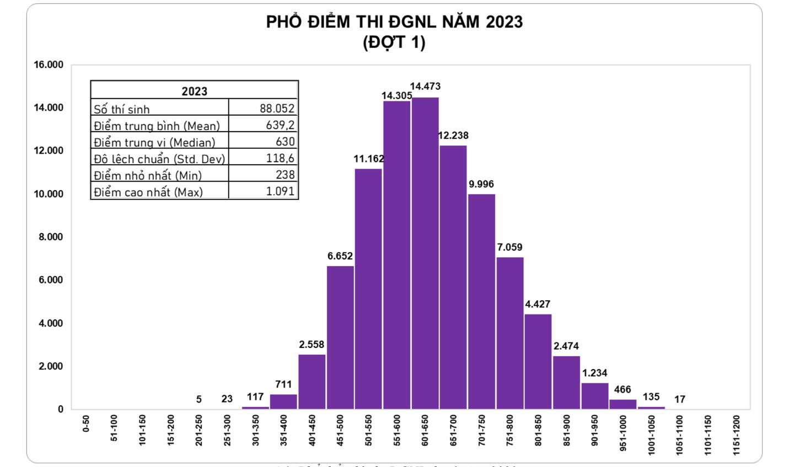
5. Outlier Analysis
Example:

Slide 21
Patterns interesting
6

Slide 22
6. Patterns Interesting
A pattern is interesting:
Easily understood by humans
Valid on a new or test data with some degree of certainty
Potentially useful
Novel (new and original, not like anything seen before)
Objective interestingness measures: Accuracy and classification
That help identify interesting pattern. But they are often insufficient unless combined with subjective measure that reflect a particular user’s needs and interests.

Slide 23
Thanks!
ThANKS FOR WATCHING!

